Slide 1


TEAM 54
Aryan Yadav
Role: Documentation
Fish Weight Prediction
Ayush Kumar
Role: Execution
Predicting a fish's weight from its species and body measurements using linear regression
Harshit Verma
Role: Presentation
AI101 MINI PROJECT | IIT ROPAR | TEAM 54
Lokesh Chabdal
Role: Video
Repo: github.com/2026eeb1331-create/AI101-mini-project
Notes:
Introduce the project name, Team 54, each member and their role, and point to the GitHub repo.

Slide 2
Problem and Data
WHAT
159
7
7
Predict a fish's weight in grams from its species and five body measurements, using linear regression.
rows
columns
species
Column | Role | Unit
Species | Input (category) | -
Length1, 2, 3 | Input | cm
Height, Width | Input | cm
Weight | Target | g
WHY
Weight can then be estimated from simple measurements, without weighing every fish.
DATASET SOURCE
Fish Market Dataset on Kaggle.com, stored as Fish.csv in our repository.
No missing values. A few length outliers were kept, since there exist genuinely larger fishes.
Notes:
What and why, the dataset source (Kaggle Fish Market), and its size and columns: 159 fish, 7 columns (species, three lengths, height, width, weight).

Slide 3




Approach
DATA
PREPARE
MODEL
OUTPUT
Fish.csv
Split + encode
Regression
Weight in g
159 fish, checked for nulls and outliers
80/20 train-test split (127/32); one-hot encode species
Learns one weight per feature from training fish
Scored on unseen fish: MAE, RMSE, R²
THREE MODEL VARIANTS, SAME SPLIT
LIBRARIES USED
Baseline
Raw measurements
Pandas
NumPy
Matplotlib
Scaled
+ StandardScaler
Volume proxy
+ Length3 × Height × Width
Scikit-learn
Notes:
Pipeline: data, then split and one-hot encoding, then linear regression, then a weight prediction scored with MAE, RMSE and R². We compared three variants: baseline, scaled, and one with an extra volume-proxy feature.

Slide 4
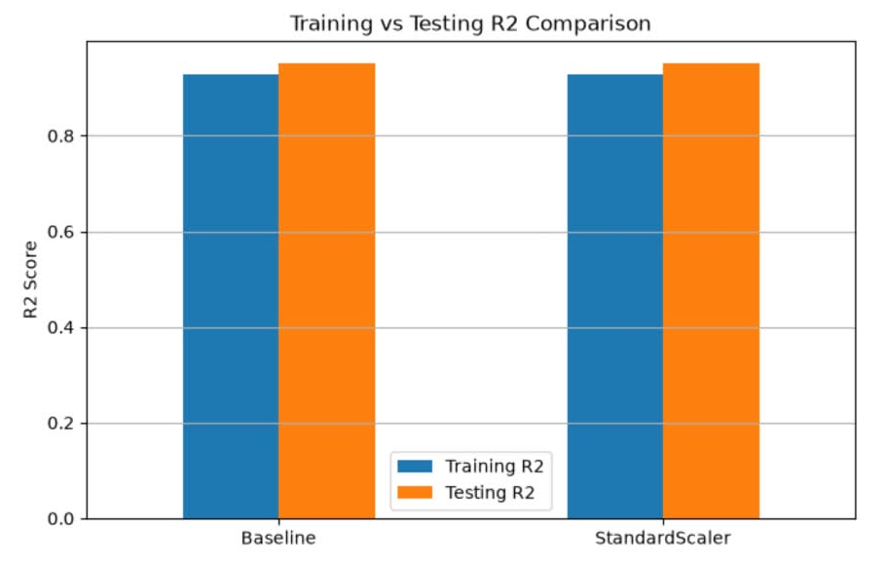
Results
Test R²
MAE
RMSE
Negative predictions
0.9507 → 0.9762
65.3 → 43.7 g
83.7 → 58.2 g
5 → 2 fish
Notes:
Key message: unscaled and scaled models are identical; adding the volume proxy cuts MAE by about 33% (65.3 g to 43.7 g) and lifts test R² to 0.9762. All numbers are on the same 32 held-out fish. Replace the dashed box with a screenshot of the notebook's final comparison table.

Slide 5


Learnings
What worked, what didn't
Who did what
AI-use disclosure
✓ Volume proxy cut MAE by a third
✓ Test R² of 0.976 on unseen fish
✗ Scaling changed nothing
✗ 2 negative predictions remain
✗ Small data, single split
Aryan: volume idea, README, requirements
Ayush: repo, preprocessing, training, plots
Harshit: presentation slides
Lokesh: demo video
ChatGPT reviewed the notebook, suggested the volume feature, corrected the RMSE table label and helped draft the README.
Results were re-run against Fish.csv to verify them.
Notes:
Worked: volume proxy. Didn't: scaling (least squares just rescales coefficients), negative predictions on tiny fish. Credit each member's contribution and state the AI use honestly.

